Slide 1


Slide 2

SGC Coaching Session ##:
Ensemble models
Session By: Mahendra Singh Chouhan

Slide 3
Agenda:
What is ensemble ?
Bias-variance tradeoff, bagging, boosting
The Adaboost Algorithm
Personalized Feedback and Doubt Resolution

Slide 4
What is an ensemble ?
Remember Random Forests! What did we do ?
We created multiple predictors (decision trees) for the same problem and made our final prediction by aggregating all the predictions from individual predictors, leading to better prediction.
In ensemble modelling, we combine the output from different base models called weak learners to get a strong model with better accuracy

Slide 5
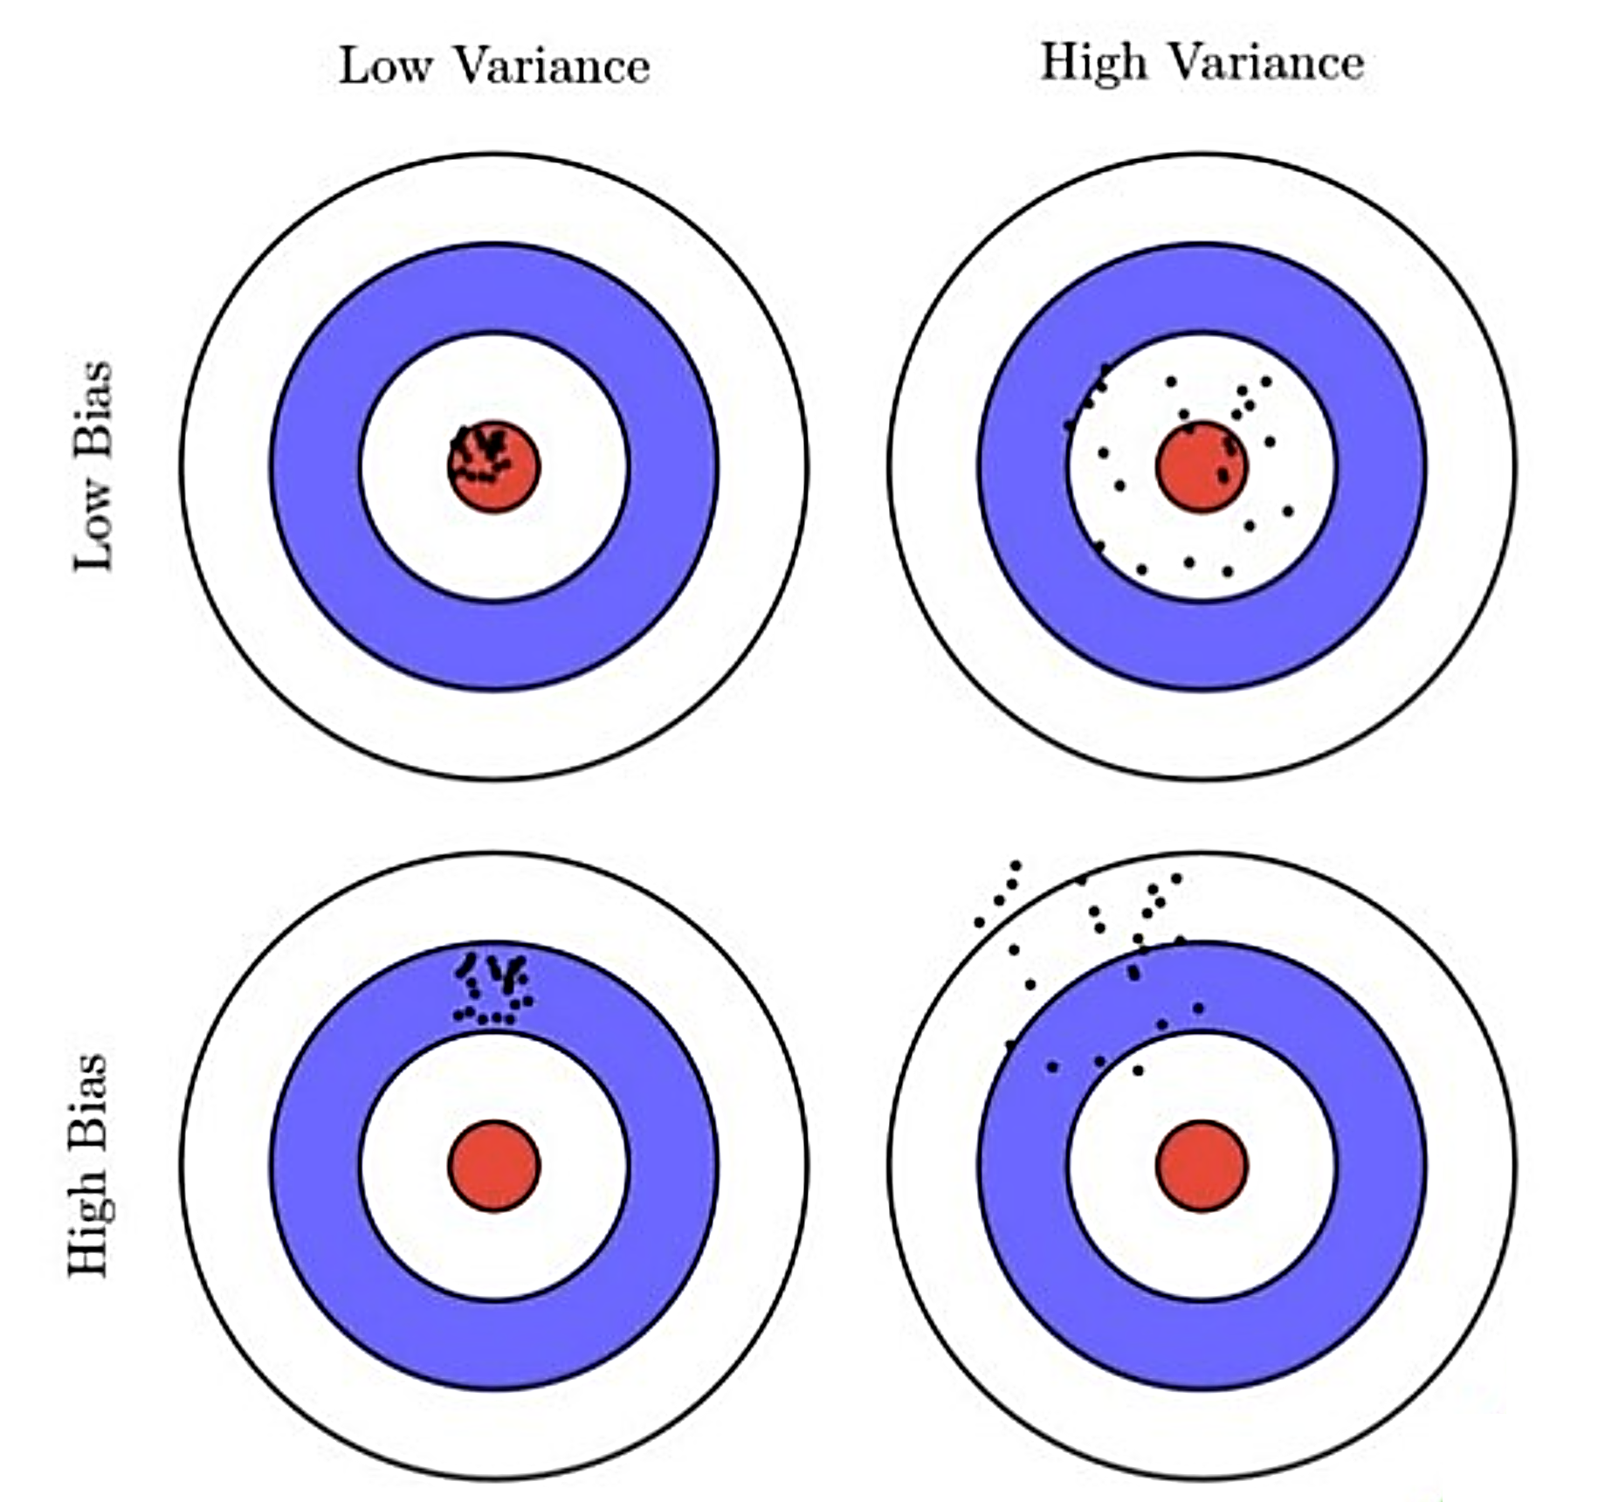
Bias – variance trade off
What is bias variance trade off ?
What do we thrive for ?
How to get there ? Low bias and low variance
Bagging
parallel learning process
increase accuracy by decreasing variance
Boosting
sequential learning process
increase accuracy be reducing bias

Slide 6
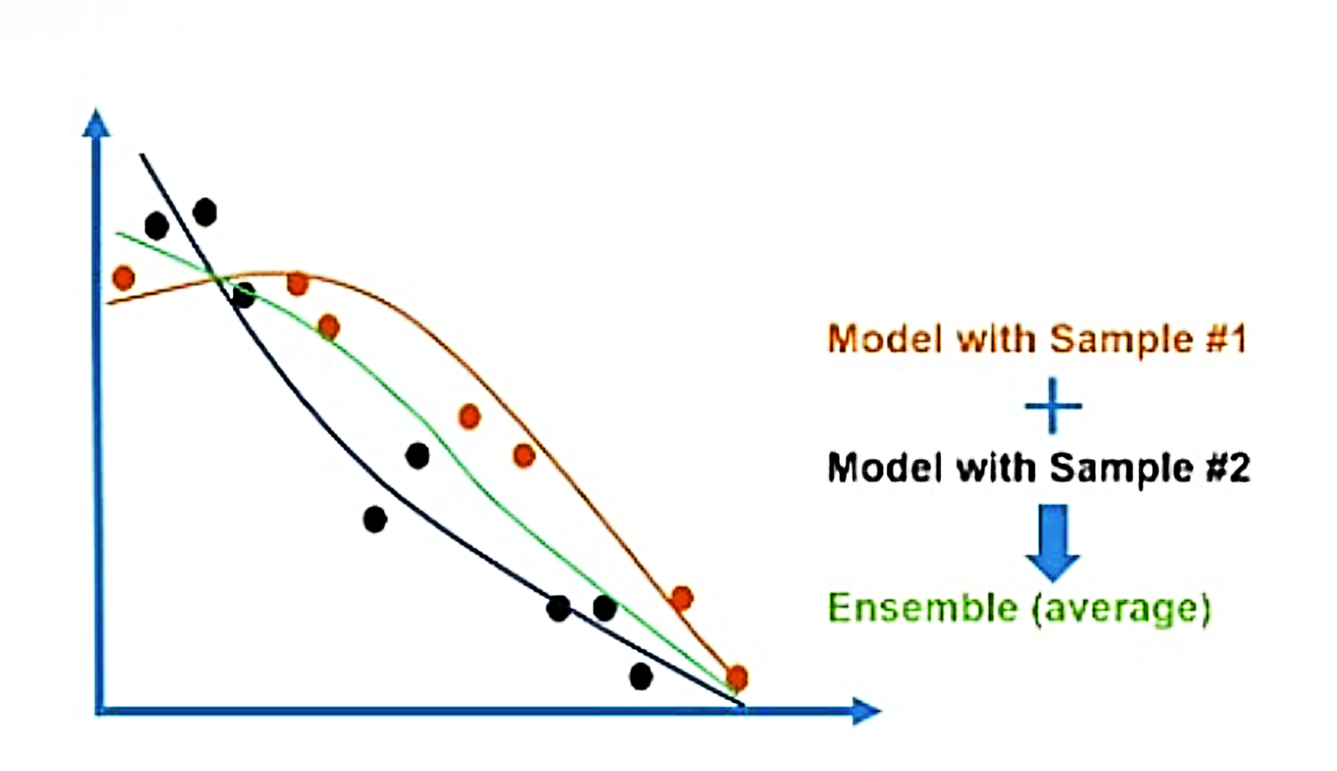
Understanding bagging… 1/3
Bagging is averaging
aka Bootstrap AGGregatING
Why do we do it ? How does bagging help ?
How do we do it ?
Which colour line will give you better predictions?
Think about you deciding to go to a movie by asking one of your friend Vs asking all your friends and aggregating their inputs
Notes:
Some pointers about bagging technique:
Aggregation function is typically the statistical mode for classification and average for regression.
Aggregation helps reduce both bias and variance.
Predictors can all be trained in parallel unleashing the potential of a GPU.
The first predictor is made using a sample 1 – Amber line
The first predictor is made using a sample 2 – Blue line
The average of amber and blue line is the green line – The final prediction is the average of two predictors.

Slide 7

Understanding bagging… 2/3
Original data set
Bootstrap samples
Train
Model 1
Train
Model 2
Train
Model 3
Aggregation
Final prediction

Slide 8
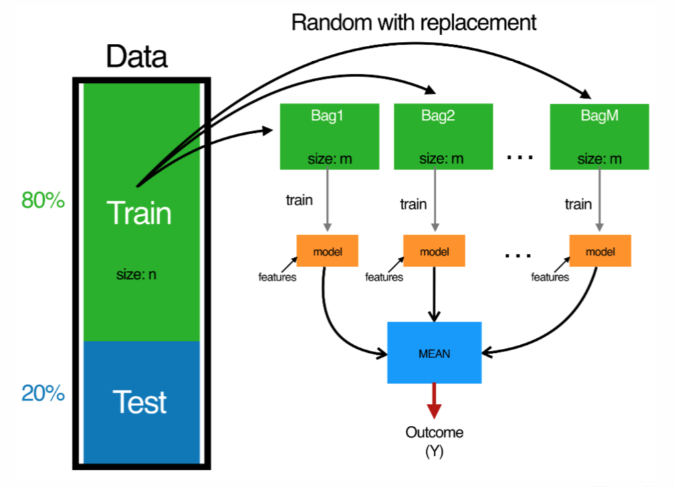
Understanding bagging… 3/3
How do we do it ?
Split your data to train and test
Do bootstrap sampling on your training dataset. Randomly sampling m records from n records for M times. You will get M bags.
Now train your model separately on each of the M datasets. You will get M models.
These M models will give you M predictions
The final prediction will be an average of all these M predictions

Slide 9

Understanding boosting…
Train
Model 1
Evaluate
Boost misclassified entries in data
Train
Model 1
Evaluate
Boost misclassified entries in data
Train
Model 1

Slide 10
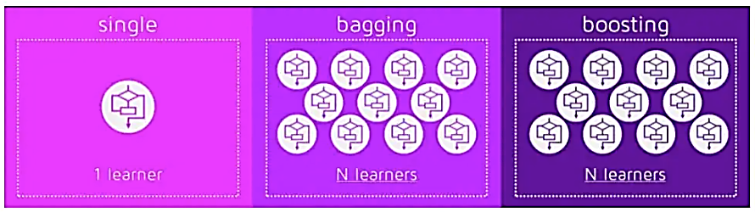
Bagging Vs boosting
Notes:
Credits for visualization : Mohit Rajput

Slide 11
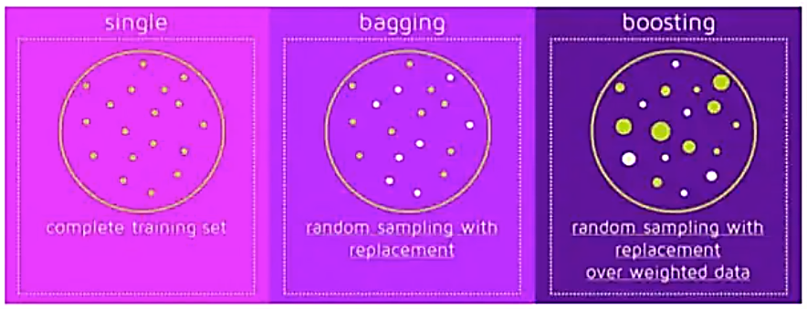
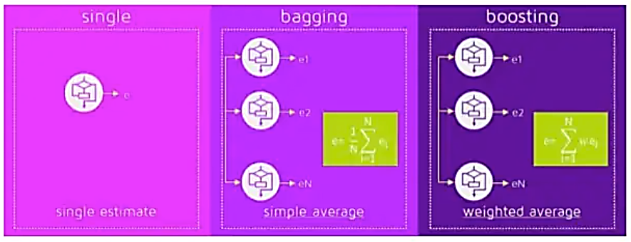
Bagging Vs boosting
Notes:
Credits for visualization : Mohit Rajput

Slide 12
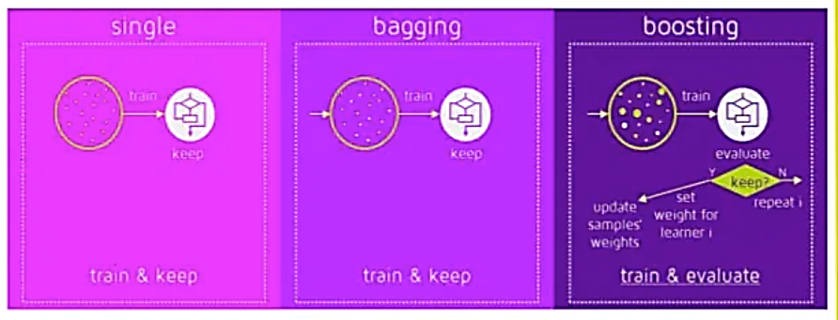
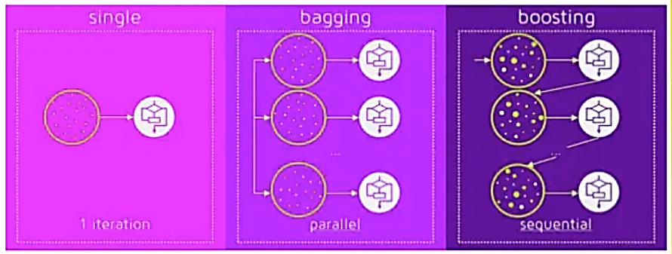
Bagging Vs boosting
Notes:
Credits for visualization : Mohit Rajput

Slide 13
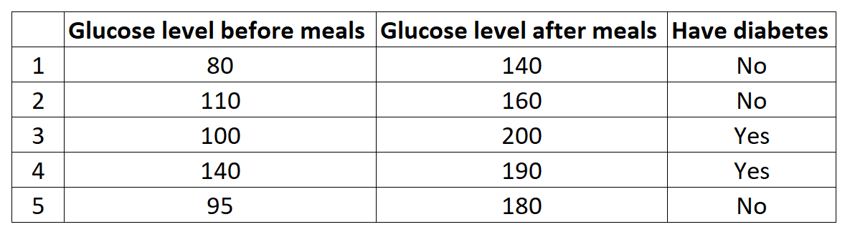
Adaboost – A boosting Algorithm
Let’s understand stumps …
X1 < 0.7
X1 >= 0.7
It’s a binary tree of depth one
The base or weak learner in case of an Adaboost model is a stump
Consider the data below …

Slide 14
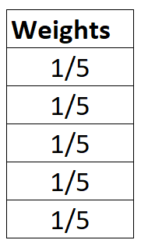
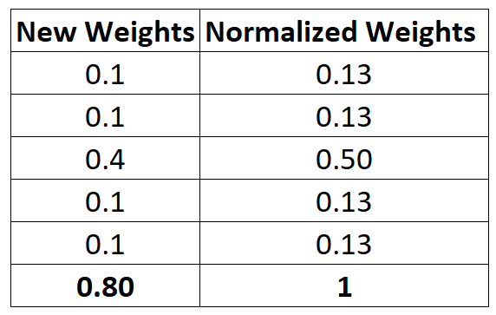
Let’s train an adaboost model
Assign equal weights to all the records. If there are n records, then each observation gets a weightage of 1/n
The algorithm creates the first stump or base learner; feature and threshold selection bases on Gini or entropy
GL before
meals < 120
GL before
meals >= 120
No
Yes
Calculate the total error
Error = 1/5
New weights are then calculated for all the observations

Slide 15
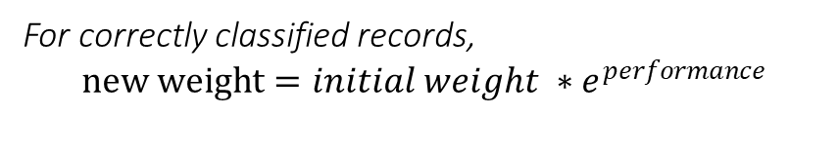

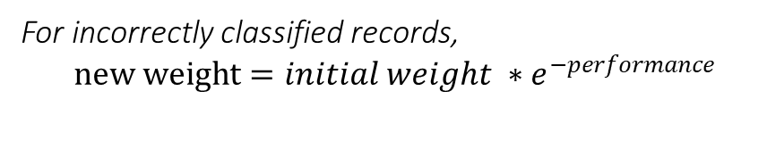
How are new weights calculated ?
1. Calculate performance of stump
$$performance =\frac{1}{2}\ln\left(−\frac{1−TE}{TE}\right)$$
2. Calculate new weights
For correctly classified records,
$$new weight=initial weight ∗e^{performance}$$
For incorrectly classified records,
$$new weight=initial weight ∗e^{−performance}$$
3. Normalize new weights so that they add up to 1

Slide 16
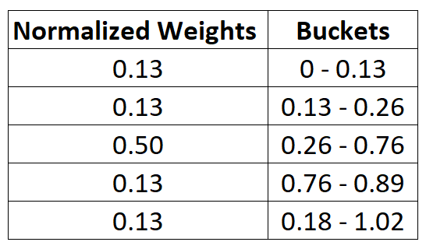
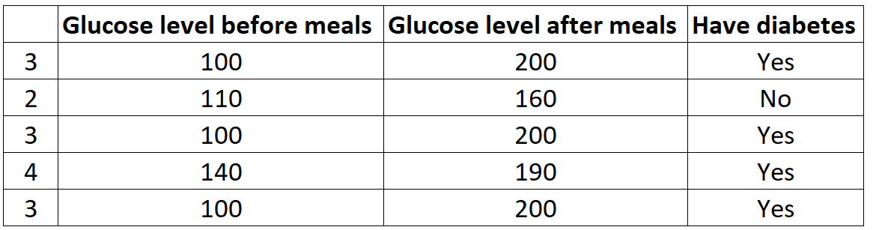
The iterating part
Create buckets using normalized weights
Select a random value between 0 and 1.02 and check which bucket it falls to.
Pick a record from the current data set which falls into that bucket
Repeat the process for n (here n=5) times, where n is the no. of observations in current data
This iterative process will result in a new data set with same no. of rows and incorrectly classified records over-represented
Create new data set with observations over or under-represented as per their weights. Here the frequency of incorrectly classified records will be more than correctly classified records.
But how is that done ?
Repeat the process till some stopping criteria is met

Slide 17
Data preparation - Adaboost
Quality Data
Because the ensemble method continues to attempt to correct misclassifications in the training data, you need to be careful that the training data is of a high-quality.
Outliers
Outliers will force the ensemble down the rabbit hole of working hard to correct for cases that are unrealistic. These could be removed from the training dataset.
Noisy Data
Noisy data, specifically noise in the output variable can be problematic. If possible, attempt to isolate and clean these from your training dataset.

Slide 18

Ask your Questions !
Questions?

